Slide 1
Digital Control System Analysis and Design
Chap. 1 Introduction
Chap. 2 Discrete Time Systems and the z-Transform
Chap. 3 Sampling and Reconstruction
Chap. 4 Open-Loop Discrete-Time Systems
Chap. 5 Closed-Loop Systems
Chap. 6 System Time-Response Characteristics
Chap. 7 Stability Analysis Techniques
Chap. 8 Digital Controller Design

Slide 2

6.1 INTRODUCTION
START: Supplementary Materials from Nise Book!
Steady-state resp.
Stability Definitions (For LTI Systems)
  Using the natural response (approaches zero)
    Stable, unstable, and marginally stable
  Using the total response (BIBO)
    Stable and unstable (includes marginally stable)
Goal: Determine if a system is stable.
Left/Right half-plane (lhp/rhp)
Poles of multiplicity greater than 1 on the imaginary axis lead to At^{n} cos(ωt+φ), where n =1, 2,…, which also approaches infinity.
Unit multiplicity!

Slide 5
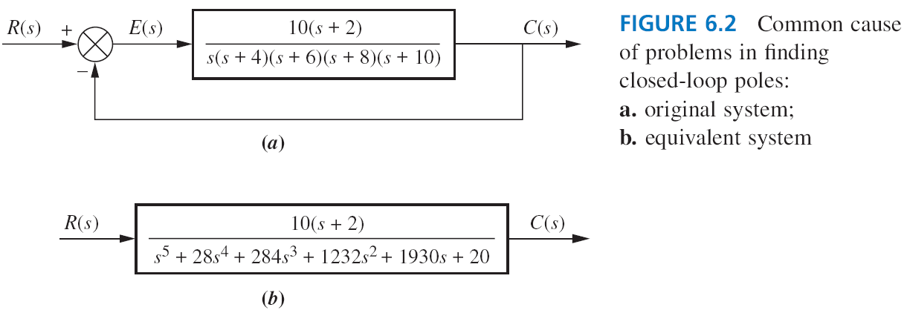
All positive coefficients (the same signs)
Stable

Slide 6
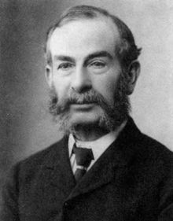
6.2 ROUTH-HURWITZ CRITERION
R-H Criterion: Check stability without the need to solve for the closed-loop systems poles.
Two Steps:
  Generate a Routh Table
  Interpret the Table
The power of R-H criterion lies in design (range of K to yield stability) rather than analysis.
Prof. Routh
(1831-1907)

Slide 7
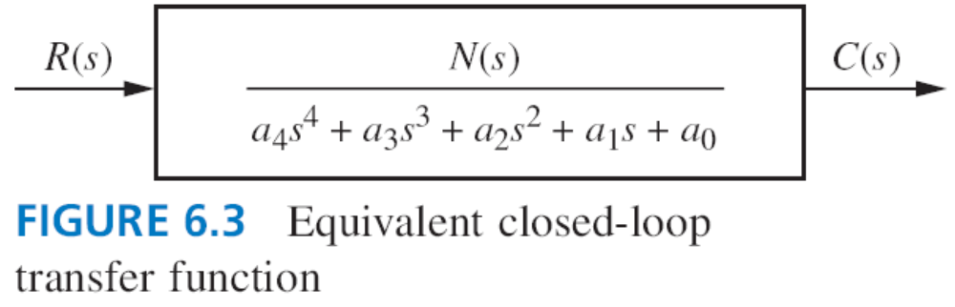
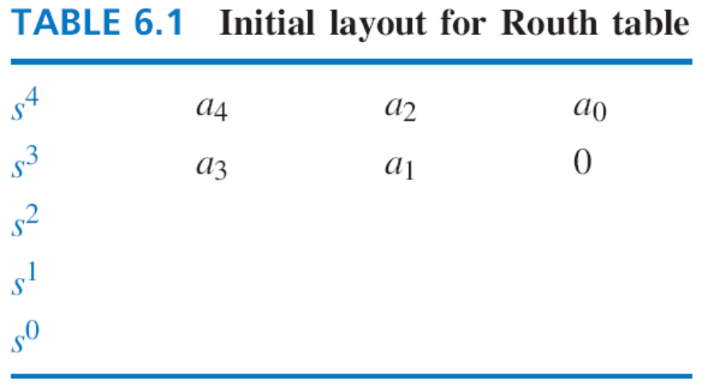
GENERATING A BASIC ROUTH TABLE

Slide 8
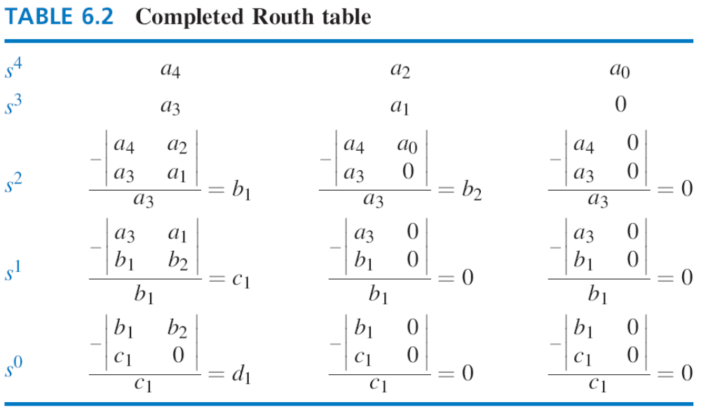

Slide 9
EXAMPLE 6.1

Slide 10
EXAMPLE 6.1
1
Unstable (2 poles in the rhp).

Slide 11
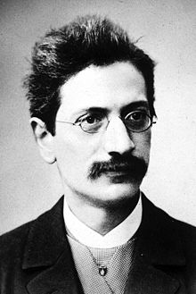
INTERPRETING THE BASIC ROUTH TABLE
The number of roots in the rhp is equal to the number of sign changes in the 1st column.
Stable → no sign changes.
Example 6.1: Unstable (2 poles in the rhp).
Prof. Hurwitz
(1859-1919)

Slide 12
6.3 ROUTH-HURWITZ CRITERION: SPECIAL CASES
Two Special Cases
  Zero Only In The First Column
    Epsilon Method: ε approaches zero
    Reverse Coefficients Method
  Entire Row Is Zero
    An even polynomial is a factor of the original polynomial
    Form an auxiliary polynomial
END: Supplementary Materials from Nise Book!

Slide 13
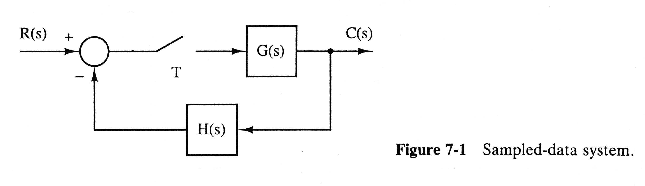
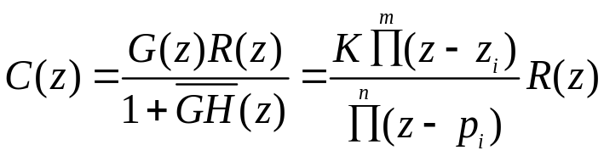
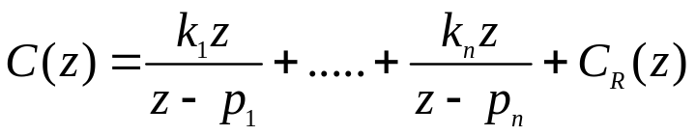
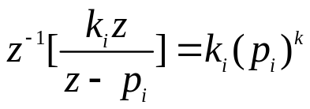
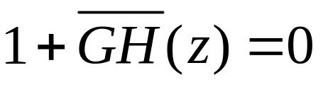
7.2 Stability
If distinct poles
Natural/transient resp.
(7.1)
(7.2)
Thus, if the magnitude is less than 1, this term approach zero as k approaches infinity.
Stable!
The characteristic equation is
(7.3)

Slide 14
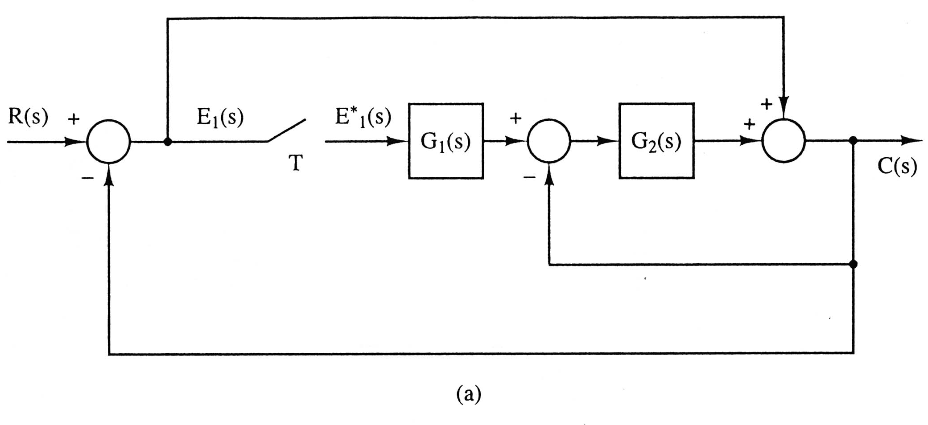
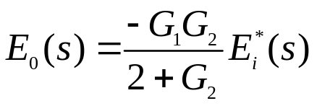
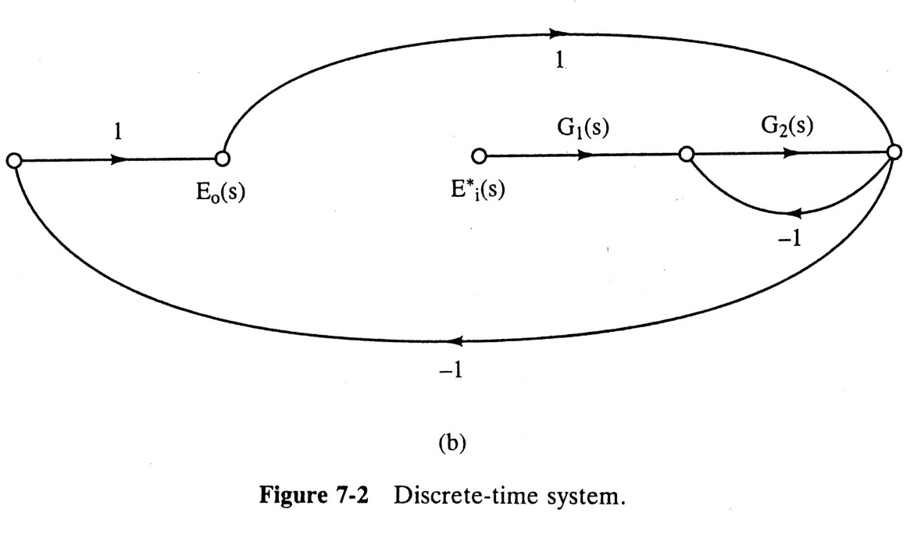
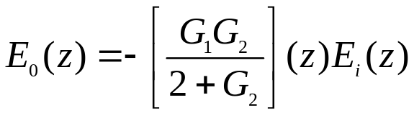
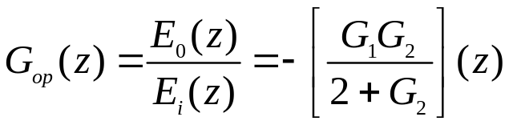

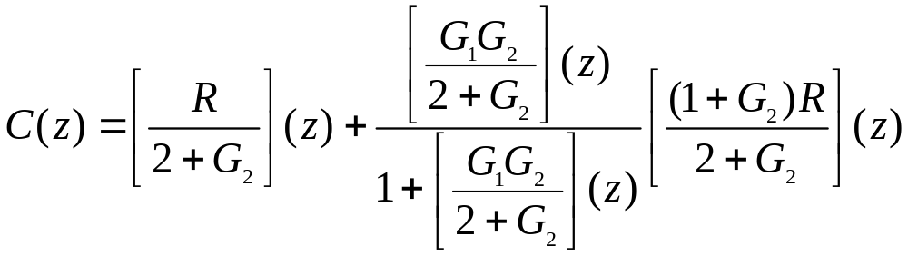
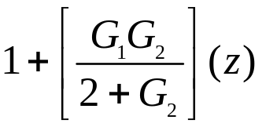
Char. Equations
方法2
Z-transform
Open the system at the sampler
Open-loop transfer function
R=0 (no input)
Stability-independent
Close-loop system: E_{i}(z)= E_{o}(z)
方法1
From Ex 5.3 (P182)
The characteristic equation
= 0

Slide 15
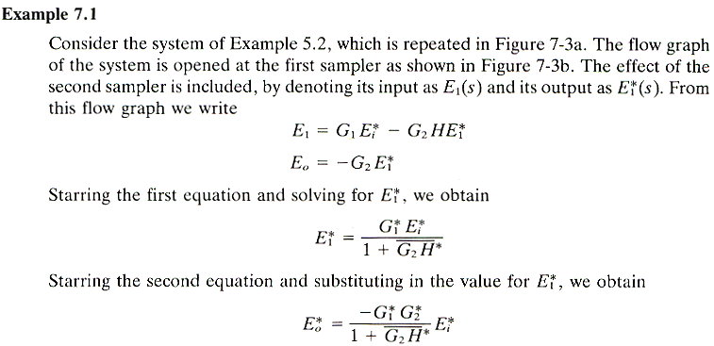
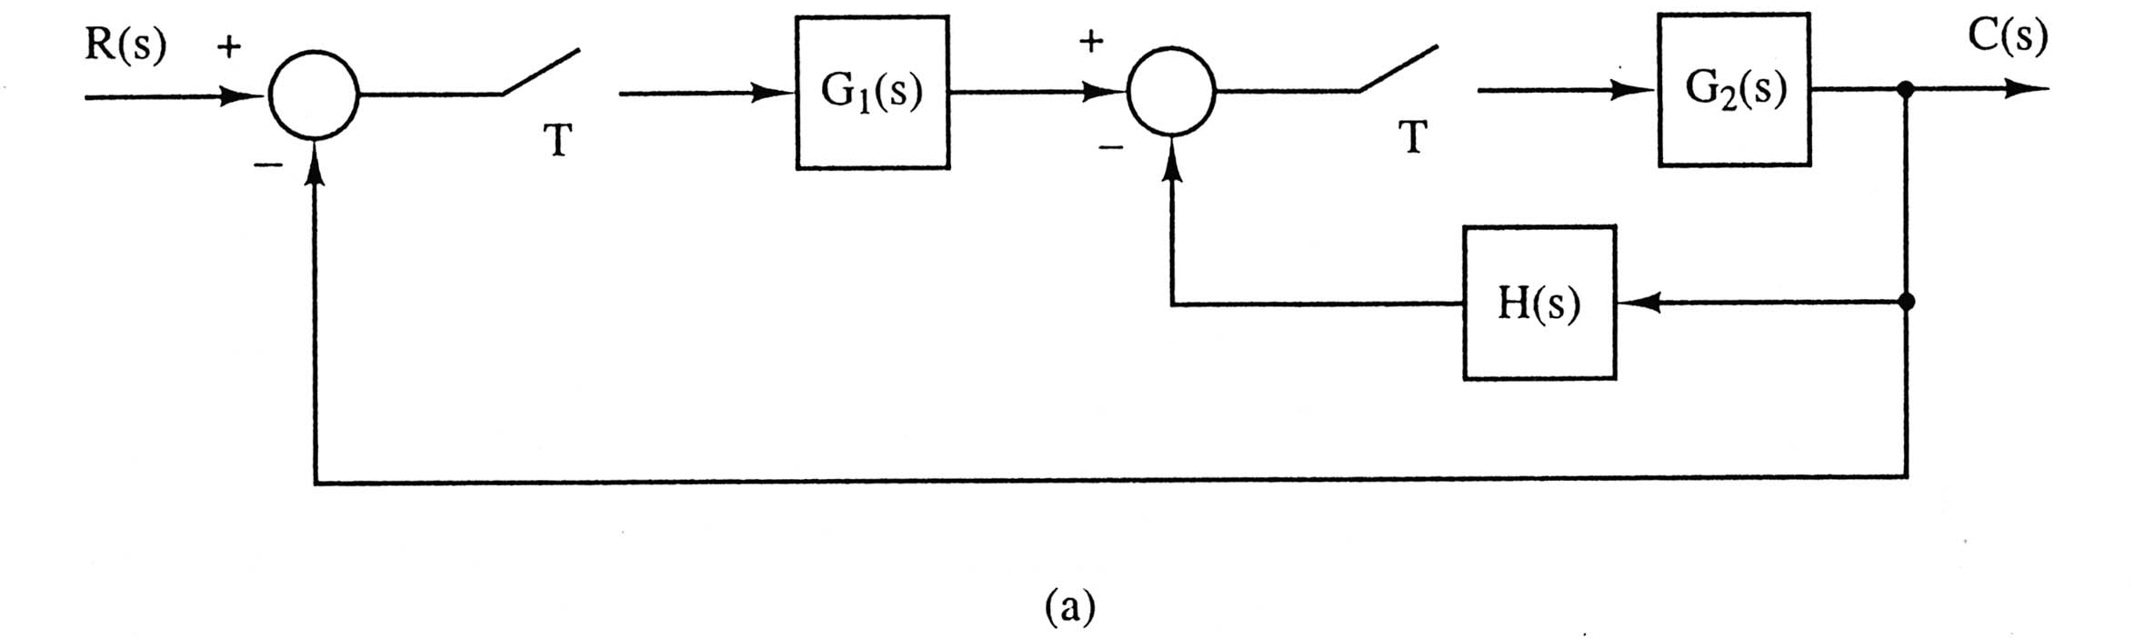
方法2

Slide 16
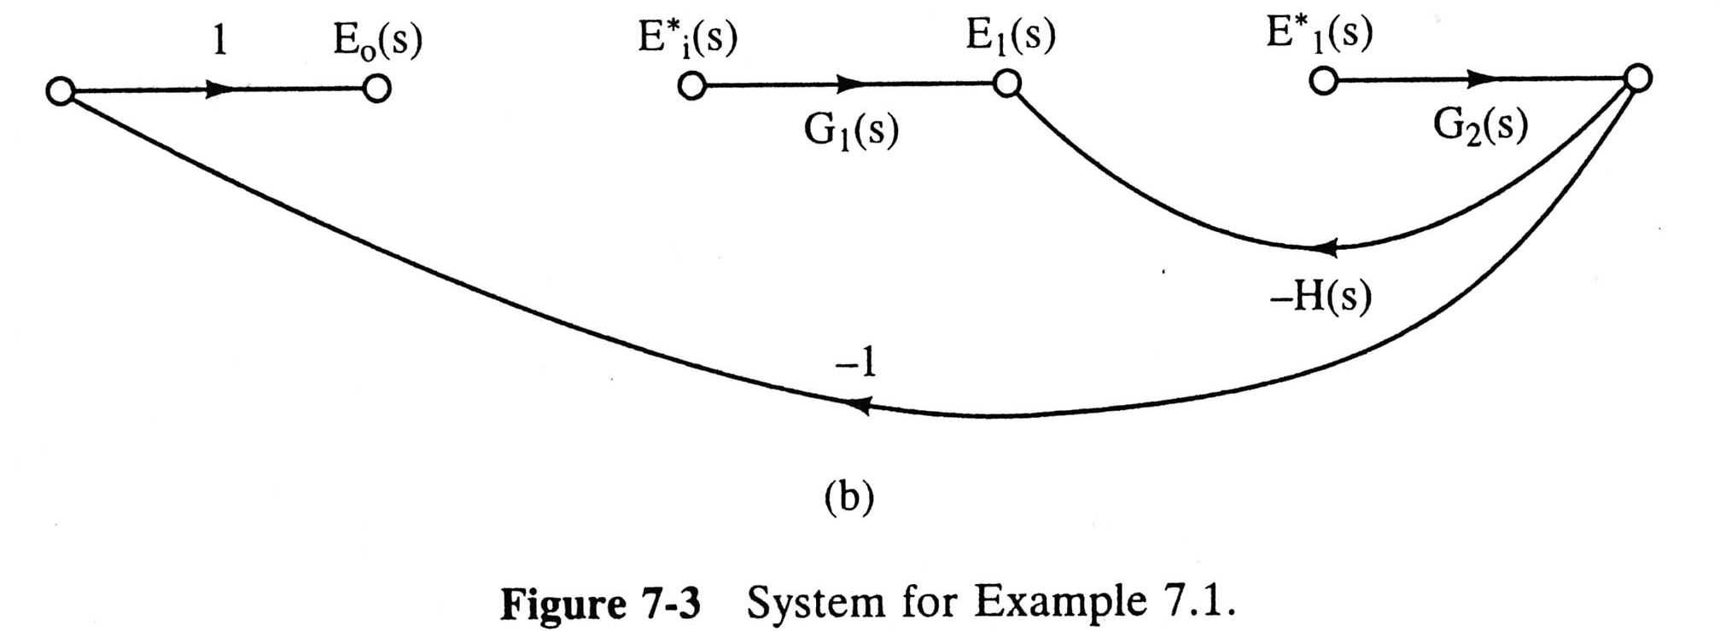
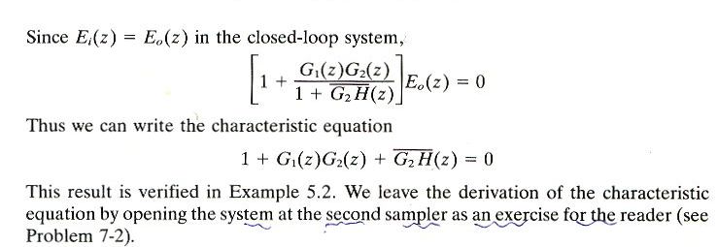
Open
at the sampler
(See P180)

Slide 17
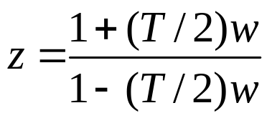
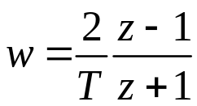

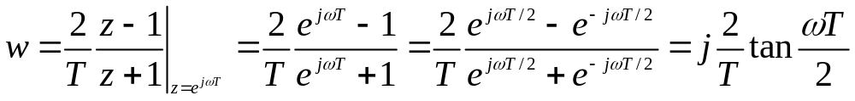
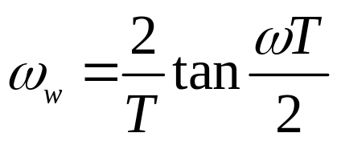
7.3 Bilinear Transformation
Use of the transform
(7.7)
or
(7.8)
jω vs. jω_{w}
On the unit circle in the z-plane
(7.9)
= jω_{w}
Let jω_{w} be the imaginary part of w. We will refer to ω_{w} as the w-plane frequency. Then can be expressed as
(7.10)

Slide 18
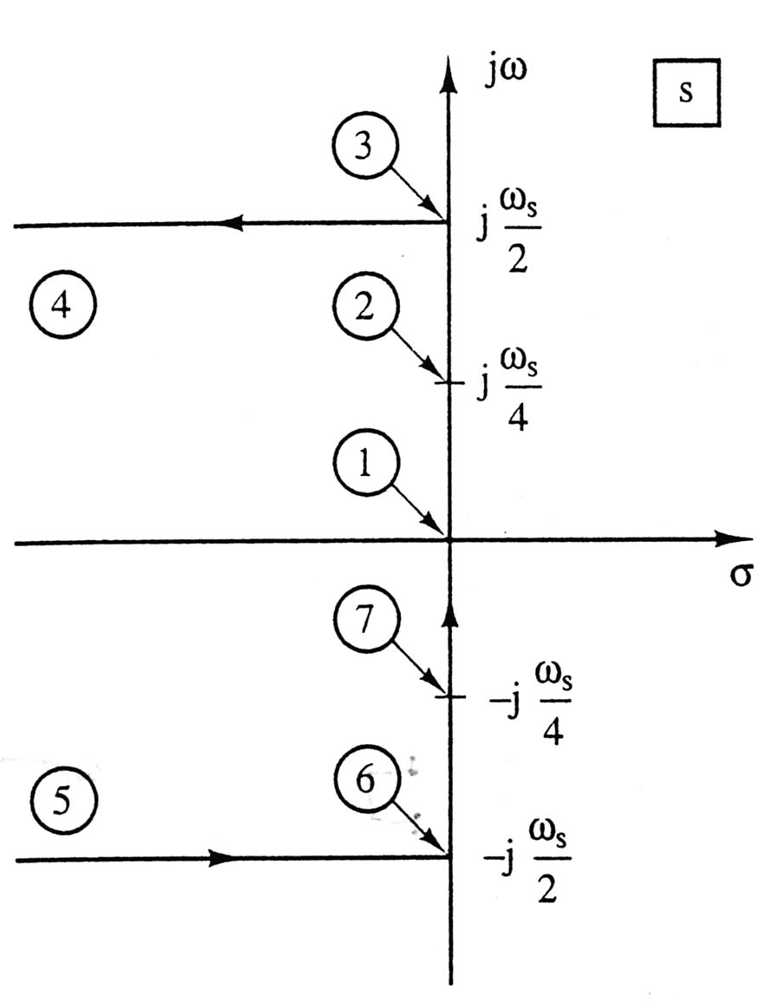
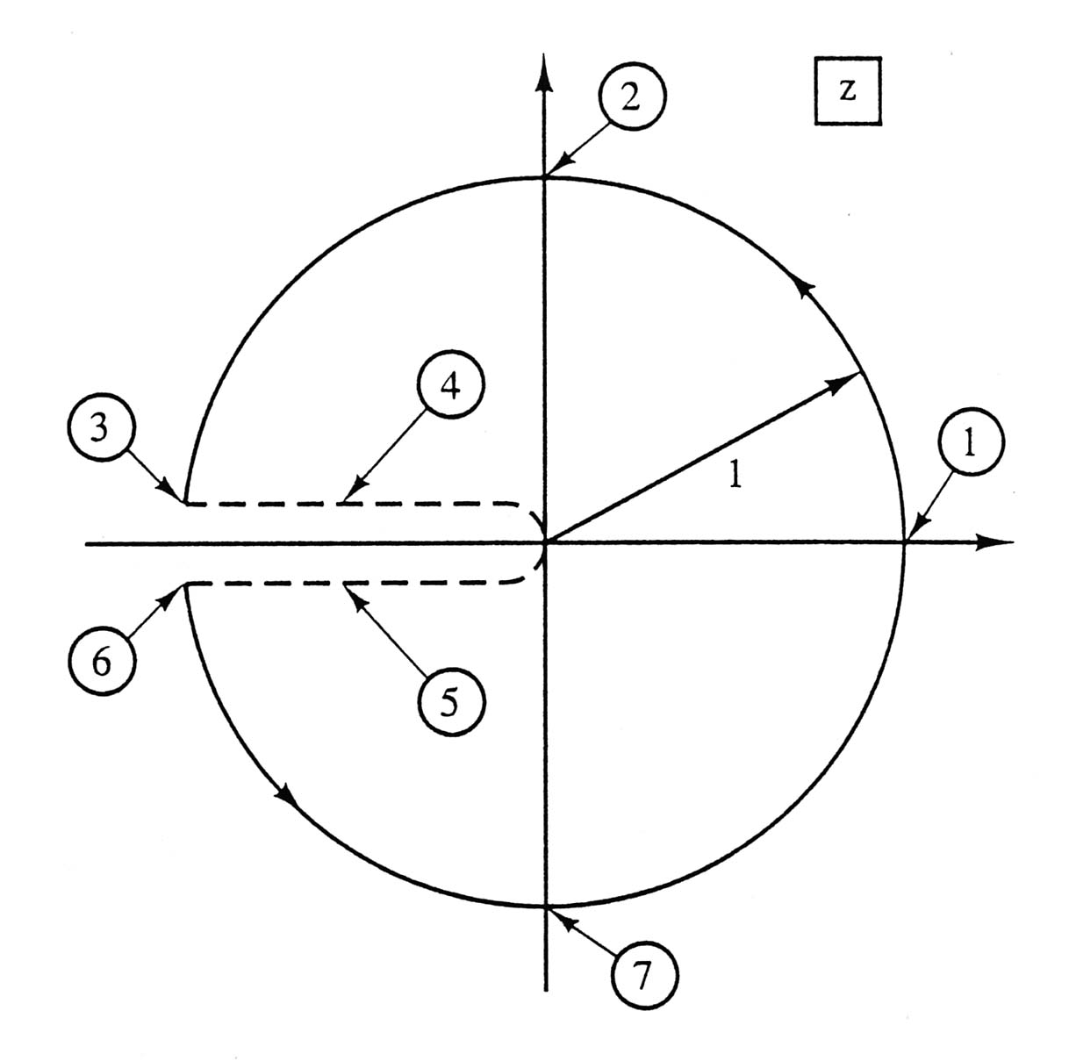
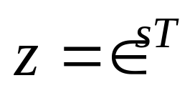
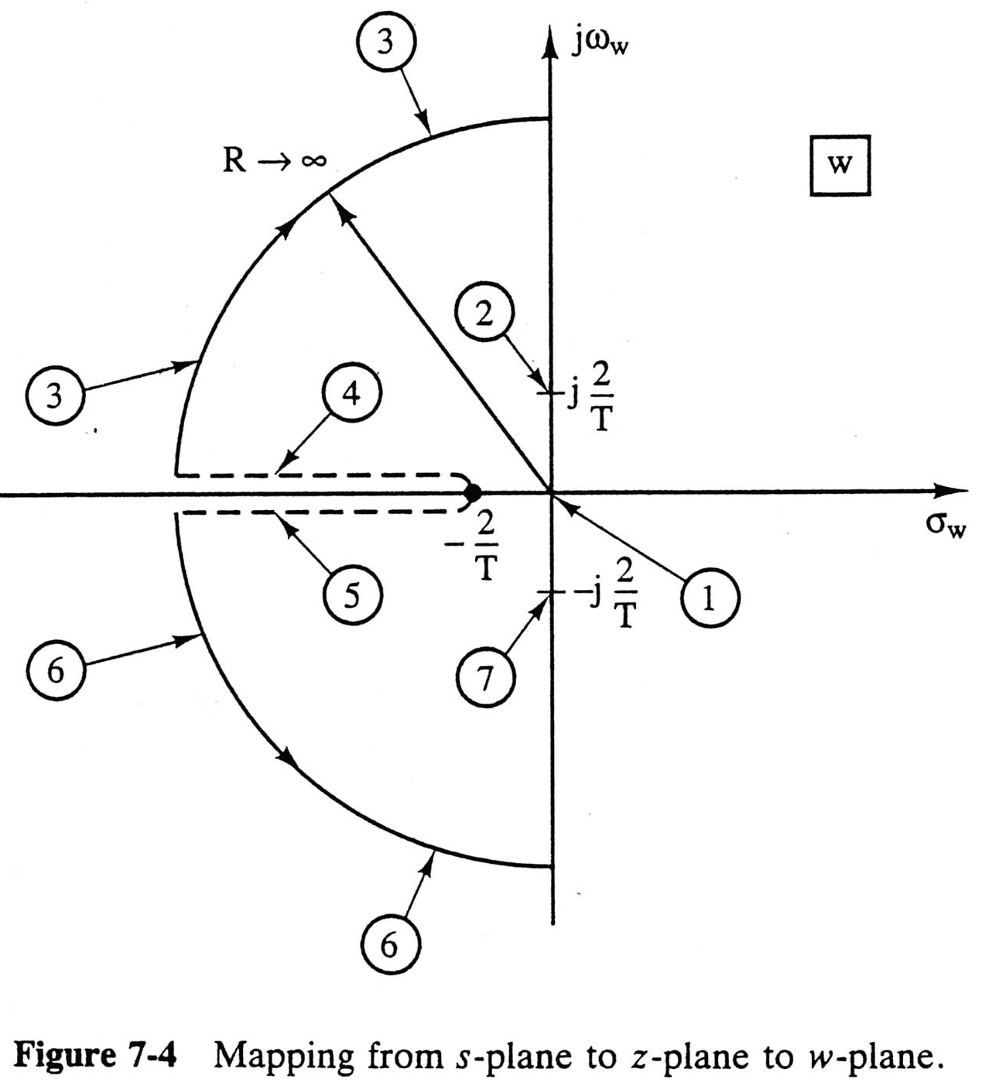
s-plane
z-plane
w-plane
z=1∠90 deg.
z=0
jω vs. jω_{w}
z=1

Slide 19
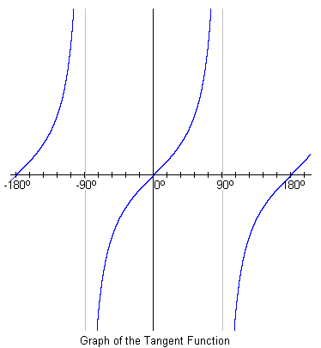
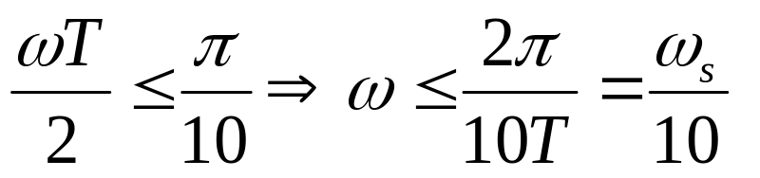
jω vs. jω_{w}
For small value of ωT,
≒ ω
(7.11)
Tangent Fcn.
(7.12)
The error in this approximation is less than 4 percent.
As ω=ω_{s}/10, the ZOH’s phase lag=18 deg. → affect stability.

Slide 20
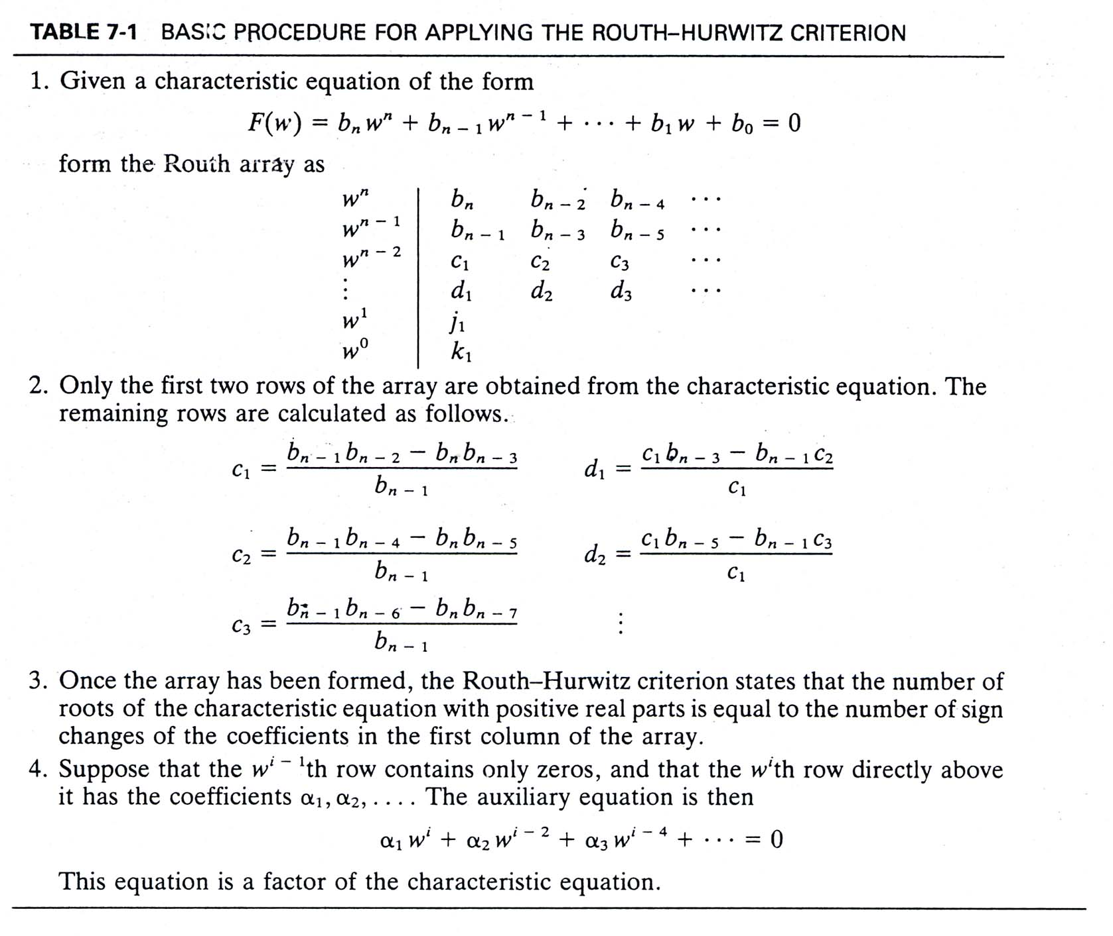
7.4 The Routh-Hurwitz Criterion
Why sign changes?
Even polynomials

Slide 21
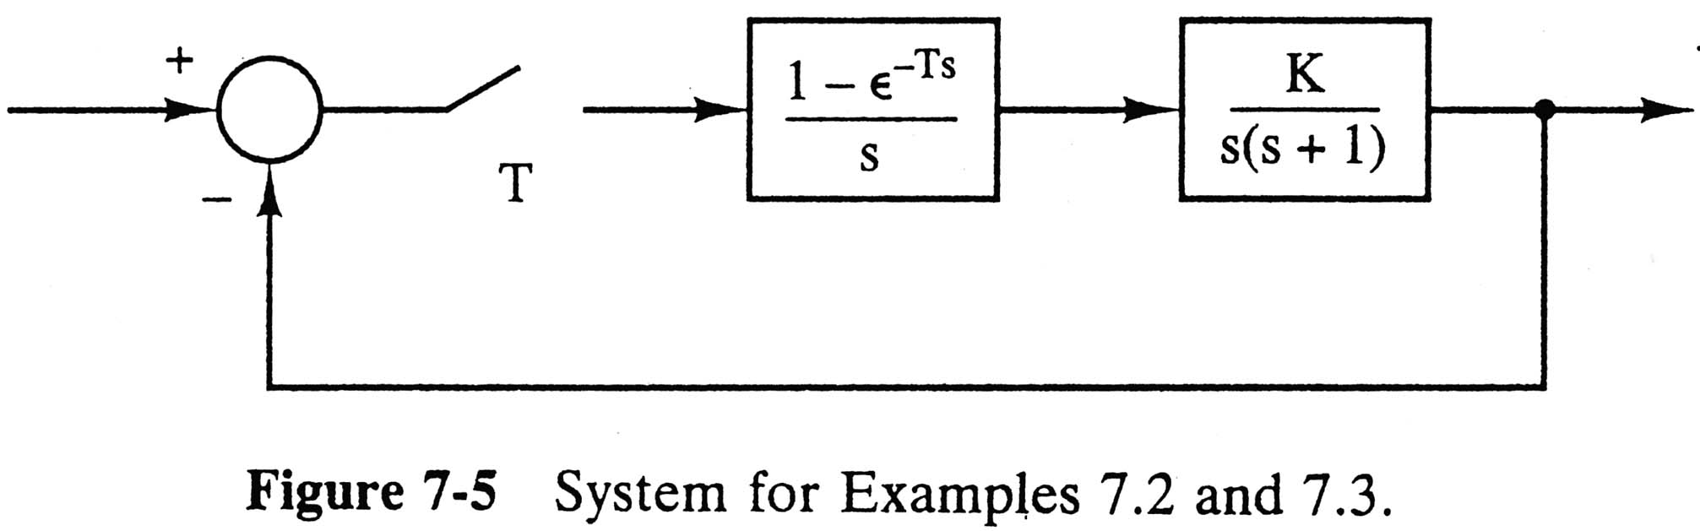
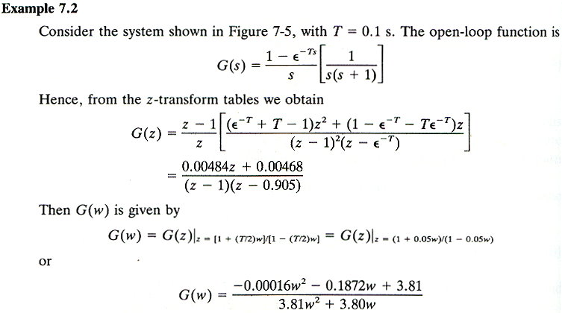

Slide 22
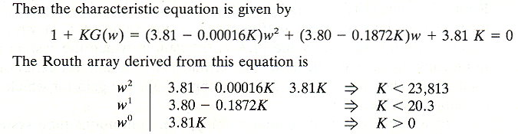
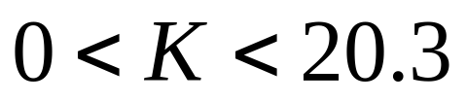
(7.3)
Stable!

Slide 23
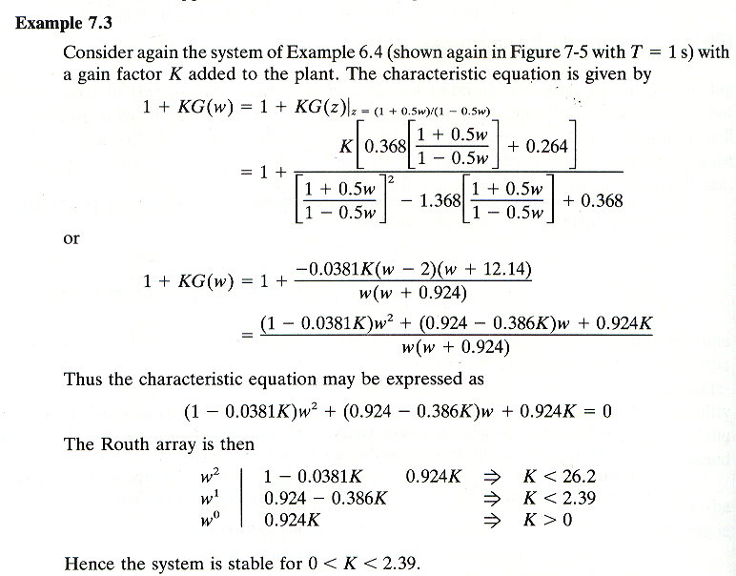
Degradation of stability as T↑
is due to the delay (phase lag)

Slide 24
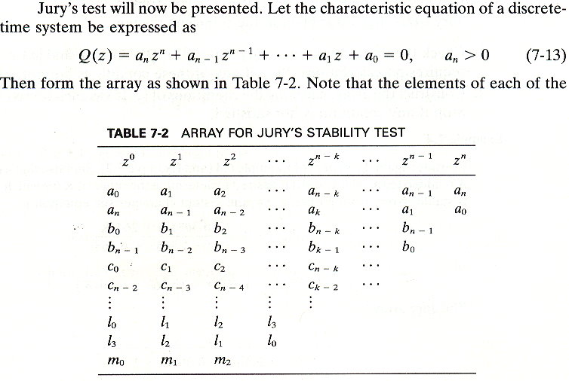
7.5 Jury’s Stability Test
in reverse order

Slide 25
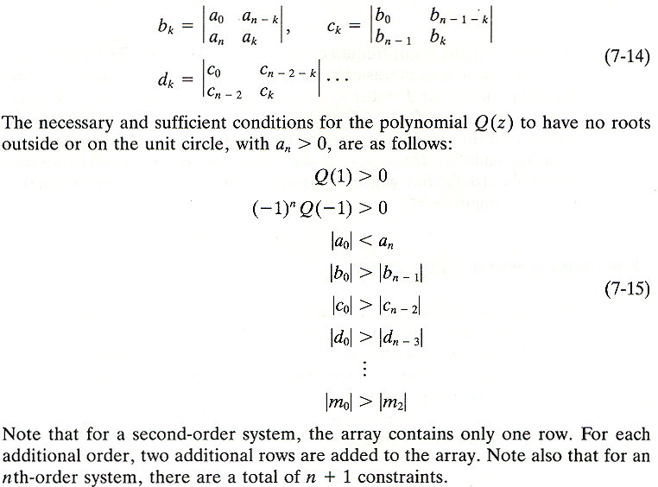
2nd-order systems.
w/o calculations.
2nd-order → 3 constraints

Slide 26
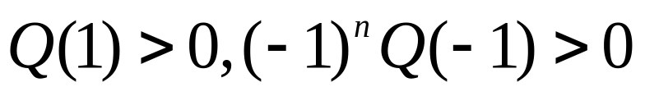
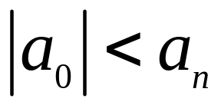
Jury’s test may be applied in the following manner :
Check the three conditions and ,which requires no calculations. Stop if any of these conditions are not satisfied.
Construct the array, checking the conditions of (7-15) as each row is calculated. Stop if any condition is not satisfied.

Slide 27
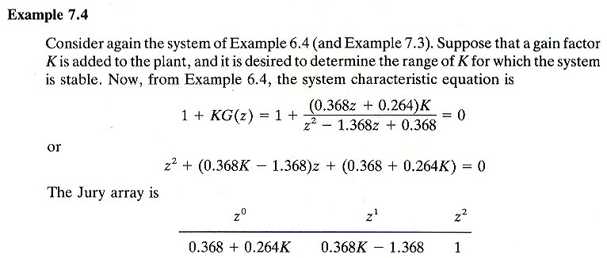
2nd-order systems
2nd-order → 1 row and 3 constraints.

Slide 28
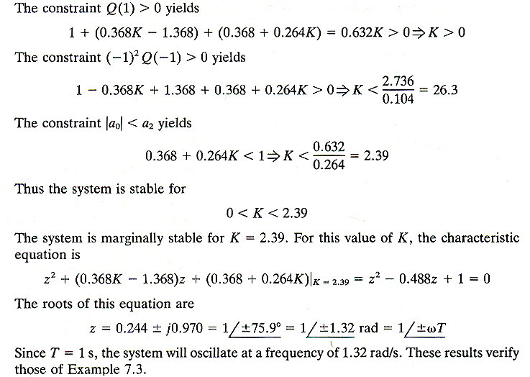
On the unit circle

Slide 29
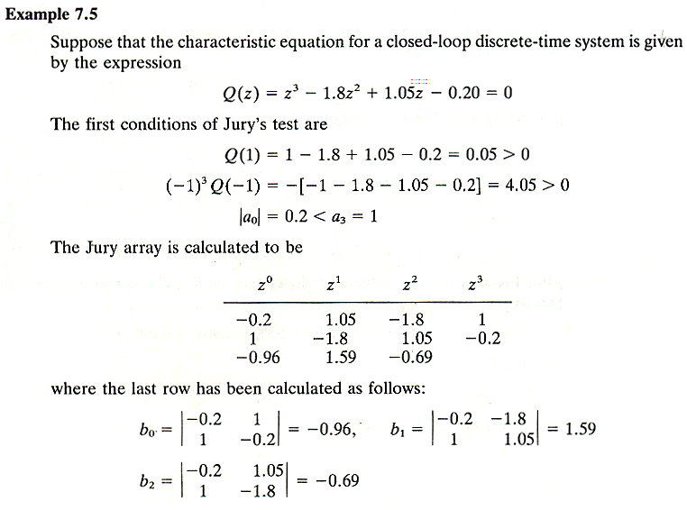
3rd-order systems
3rd-order → 3 rows and 4 constraints.

Slide 30
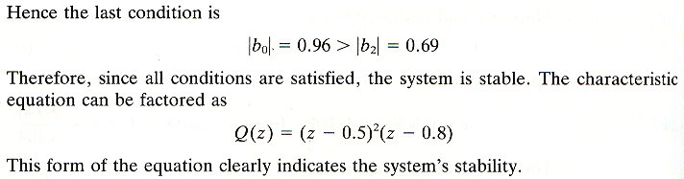
CT (S-plane): Routh-Hurwitz Criterion
DT (Z-plane): Jury’s Test
For high-order systems

Slide 31
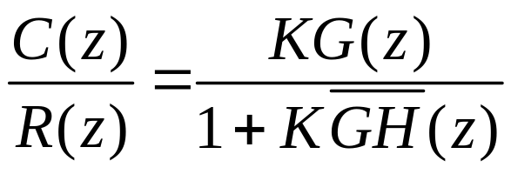
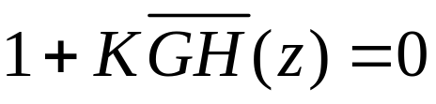
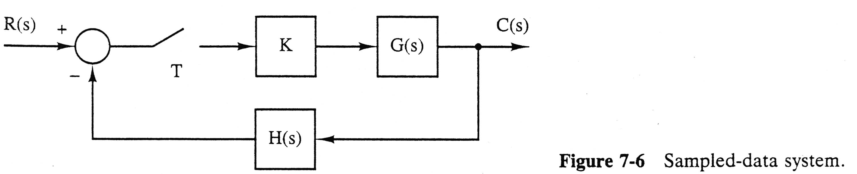
7.6 Root Locus
For the LTI sampled-data system of figure 7-6
The system characteristic equation is
(7.16)

Slide 32
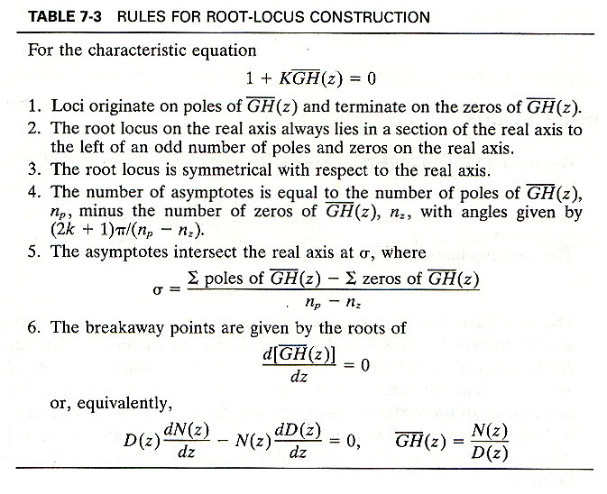

Slide 33

8.1 INTRODUCTION
START: Supplementary Materials from Nise Book!
THE CONTROL SYSTEM PROBLEM
The CL poles change with system gain K.

Slide 34
N: Numerator
D: Denominator
The CL zeros = G’s zeros + H’s poles.
The CL poles change with system gain K.

Slide 35



8.2 DEFINING THE ROOT LOCUS

Slide 36

K = 0, open-loop poles
For K > 0

Slide 37


K<25, overdamped,
K=25, critically damped,
K>25, underdamped.
Root locus
For K>25, as K↑
→ ω_{d} ↑, σ_{d} =const, and ζ↓.
→ T_{p} ↓, T_{s}=const, T_{r} ↓,and %OS↑.
Root locus: the paths of the CL poles as the gain is varied.
Review Example 5.4.

Slide 38

8.3 PROPERTIES OF THE ROOT LOCUS
KGH: Open-loop TF (loop gain)
For closed-loop poles
Example: CameraMan

Slide 39

An Example

Slide 40
Open-loop TF
Closed-loop TF
Consider the point: -2 + j3
Not a root locus point (not a closed-loop pole for any gain K).

Slide 41


Case1:
Not a root locus point.
Case2:
A root locus point.
K= 0.33
Summary
  Check angle
  Find K = 1 / |GH|

Slide 42
8.4 SKETCHING THE ROOT LOCUS
Sketch the root locus w/o the effort to plot the locus.
Five Rules
  Num. of branches: num. of closed-loop poles.
  Symmetry: about the real axis.
  Real-axis segments: left of an odd num. of poles/zeros. [see Fig. 8.8-9]
  Starting & ending points: begins at the GH poles and ends at the GH zeros, where GH is the open-loop TF. [see Fig. 8.10]
  Behavior at infinity: approaches straight lines as asymptotes.
Physically realizable systems cannot have complex coefficients.

Slide 43

3) Real-axis Segments
Observations
  Angle of conjugate poles/zeros is zero.
  Angle of poles/zeros at the left of the test (respective) points is zero.

Slide 44


4) Starting and Ending Points
K is small
(8.23)
poles
K is large
(8.3)
(8.24)
zeros

Slide 45

5) Behavior at Infinity
Physical systems have more finite poles than zeros.
Asymptotes
Details of derivation: See Appendix L.1.

Slide 46

EXAMPLE 8.2

Slide 47

EXAMPLE 8.2
# asymptotes = # finite poles － # finite zeros

Slide 48


Slide 49

8.5 REFINING THE SKETCH
1) REAL-AXIS BREAKAWAY AND BREAK-IN POINTS
Angle: 180° / n,
where n is the num. of CL poles arriving at or departing from the single breakaway or break-in point on the real axis.

Slide 50



Max gain along the real axis.
Min gain along the real axis.

Slide 51

EXAMPLE 8.3

Slide 52


EXAMPLE 8.3

Slide 53

EXAMPLE 8.5
2) THE jω-AXIS CROSSINGS
Continue Example 8.2

Slide 54

EXAMPLE 8.5

Slide 55

EXAMPLE 8.5

Slide 56

3) ANGLES OF DEPARTURE AND ARRIVAL
Complex poles:
Find θ₁ (angle of departure)

Slide 57

Complex zeros:
Find θ₂ (angle of arrival)
1

Slide 58


Example 8.6
1

Slide 59

Asymptotes:
σ_{a}= -3/2,
θ_{a}= π/2, 3π/2

Slide 60
4) PLOTTING AND CALIBRATING THE ROOT LOCUS
Continue Example 8.2
ζ =0.45
K = ?
Fig. 8.12

Slide 61


r =2,
END: Supplementary Materials from Nise Book!

Slide 62


Marginally Stable
Method-1

Slide 63


Method-2
z =-2.08
z = 0.65

Slide 64



Slide 65

K = 0.2

Slide 66





7.7 The Nyquist Criterion
The transfer function for the continuous-time system of figure 7-11a is
And for the sampled-data system of Figure 7-11b the transfer function is
The characteristic equation for the continuous-time system is
For the sampled-data system, the characteristic equation is
(7.17)
(7.18)
(7.19)
(7.20)

Slide 67



The characteristic equation of the sampled-data system can also be written as
Recall that the continuous-time system is stable if the roots of are all contained in the left half-plane. similarly, the sampled-data system is stable if the roots of all lie in the left half-plane, or if the roots of all lie within the unit circle.
Theorem
(7.21)
(7.22)
Phillips’s textbook
N: clockwise

Slide 68

10.3 INTRODUCTION TO THE NYQUIST CRITERION
Supplementary Materials
DERIVATION OF THE NYQUIST CRITERION

Slide 69
GH (OL), 1+GH, and T (CL)
Supplementary Materials
1+GH and GH (OL)
Poles are the same.
1+GH Zeros
= CL Poles

Slide 70

Mapping Points & Contours
Supplementary Materials
Q point
mapping

Slide 71


Nyquist Criterion
Supplementary Materials
Nise’s textbook
N: counterclockwise
Inside Contour A (move clockwise)
  Zero: clockwise
  Pole: counterclockwise
N = P - Z, N: CCW around origin

Slide 72

Nyquist Plot of GH
Supplementary Materials
F(s)=1+GH, inside Contour A: Z = P - N,
where N is CCW around origin
What if F(s)=GH?
Z → CL poles in rhp (unknown)
P → OL poles in rhp (given)
N → CCW around -1 (found)

Slide 73

APPLYING THE NYQUIST CRITERION TO DETERMINE STABILITY
Supplementary Materials
(a) Z = P – N
= 0 – 0 = 0
Stable!
(b) Z = P – N
= 0 – (-2) = 2
Unstable!

Slide 74


S-plane

Slide 75

-1
0
Z = 0
Stable!

Slide 76




(7.28)
= number of clockwise encirclements of the -1 point
= number of zeros of the characteristic equation outside the unit circle
= number of poles of the open-loop function, or equivalently poles of the characteristic equation, that are outside the unit circle

Slide 77


Z-plane

Slide 78


-0.717
0.368
1
Z = 0
Stable!

Slide 79

“Phase lag” leads to phase margin Φ_{M}↓.

Slide 80

Table 7-4 gives the functions and the range of variables required for the calculation of the Nyquist path
Example 7.9
Example 7.10
Example 7.11

Slide 81

10.6 GAIN MARGIN AND PHASE MARGIN
Supplementary Materials
Nise’s textbook
Assume N = 0 for stability
→ P = 0 (no OL poles in rhp)

Slide 82


Phillips’s textbook
The gain margin is 1/a
The phase margin is

Slide 83

7.8 The Bode Diagram

Slide 84


Slide 85


Slide 86



Slide 87


Slide 88

7.9 Interpretation of the Frequency Response

Slide 89

7.10 Closed-Loop Frequency Response
OL

Slide 90

Figure 7-24
Constant M circles:
The locus of the CL Magnitude FR

Slide 91

Constant N circles:
The locus of the CL Phase FR

Slide 92

Figure 7-26
Nichols Chart: Gain-Phase Plot (M in dB)
CL
OL (to find ω_{BW})
(-6, -7.5)dB at (-135, -225) °

Slide 93


Figure 7-27
Example 7.13

Slide 94
See Summary (P272)
Problems: 7, 8, 13, 14, 19
Test Bank

